Slide 1

Reducing Investors/Traders risk using NLP and DEEP LEARNING
Presented by
Satyam Kshirsagar

Slide 2
Goal behind the project
Analyzing and predicting future stock price for particular organization not only base on historical stock price data but also trying to capture effect of news related to that particular organization or related to that sector by analyzing sentiments and reducing traders/investors risk

Slide 3
Little history behind choosing this project
i had keen interest in share market and I generally used to take calls on the basis of technical analysis only
Once I had one intraday position open and everything was going correct according to my technical analysis
I had made good chunks of money and I was about to hit the target but some bad news came out in the market related to that sector and I loose out most of money
And from there, I got idea related to this project where I can capture the sentiments of market along with technical analysis for better accuracy

Slide 4
Why and How NLP for stock price prediction ?
Generally stock price can be predicted using Time-series or by using deep learning approach like LSTM
what if LSTM predicted, price to go up based on learning from previous data and suddenly any bad news out in the market?
Prediction might be correct till news wasn't there in the market and one might be making huge profit but because of bad sentiments in market, price may go down
So using NLP, we can judge the sentiments of markets and using LSTM we can achieve safe prediction can reduce risk for trader to some extend

Slide 5
Brief-workflow…..
in this project I have consider financial sector for analysis
HDFC bank’s stock price is predicted by combining two different datasets
1) Indian Financial News Dataset
2) HDFC bank stock price dataset
Sentiments for news datasets are achived and are appended in the stock price dataset
And hence model is trained on historical stock price and sentiments for news on that perticular day to predict next day opening price using LSTM

Slide 6
Sentiment analysis
Analyzing news, comments, feedback that is where the given response is positive, negative or neutral
We can achieve sentiment score also for comments using
NLTK’s inbuilt library's like vedar, textblob
But for this project I have used RoberTa based Transformers
library for sentiment –analysis by hugging-face
Using Transforms library news are converted into sentiments scores

Slide 7
Why transformers library?
comments | Textblob | vedar | Transformers
HFDC bank looses its 2% share in single trading session | -0.07 | 0.1531 | -0.9995
sebi has decided to increase repo rate | 0.0000 | 0.3182 | -0.92
HDFC bank is getting famous between investors | 0.500 | 0.0000 | 0.9989
financial sector is in boom | 0.000 | 0.0000 | 0.9982
covid is hitting financial sector badly | -0.35 | -0.4767 | -0.999
goverment has dicided to reduce its holding from hdfc bank | 0.0000 | 0.0000 | -0.9900
indias GDP is expected to grow 5% by 2025 | -0.100 | 0.0000 | 0.9999
hdfc bank has decided to increase interest rate by 2% | 0.0000 | 0.64 | -0.8749

Slide 8
Data Preprocessing
Indian financial news data-set is from 2003 to 2020 with shape of (50000,4) where as HDFC stock price dataset is from 2000 to 2021
with shape (5306,4)
Both datasets are converted into datetime format
Using for loop news related to all other banks are removed
c=[]
a=['dcb','maharashtra','idfc','yes','kotakbank','indusindbk','axisbank','sbin','baroda','canara','overseas','punjab']
for j in range(0,len(df)):
for i in str(df['Title'].iloc[j]).lower().split():
if i in a:
df.replace({df['Title'].iloc[j]:np.nan},inplace=True)
break
most of times, for single day, we have got many news so using groupby function mean sentiments calculate for that day
new_df=df.groupby(['Date'],as_index=False)['sentiments'].mean()

Slide 9
Also on few of days we haven't got any news so filling null values with neutral sentiment score (0.0)
final_df['sentiments'].fillna(0.0,inplace=True)
Market is open from Monday to Friday , so forward filling of Friday’s values for weekends
final_df['Open']=final_df['Open'].ffill()
Feature scalling:
standerdization of data is carried out because opening, closing price of stock are smaller values upto thousands but volume is lacks or few thousand lacks sometime

Slide 10
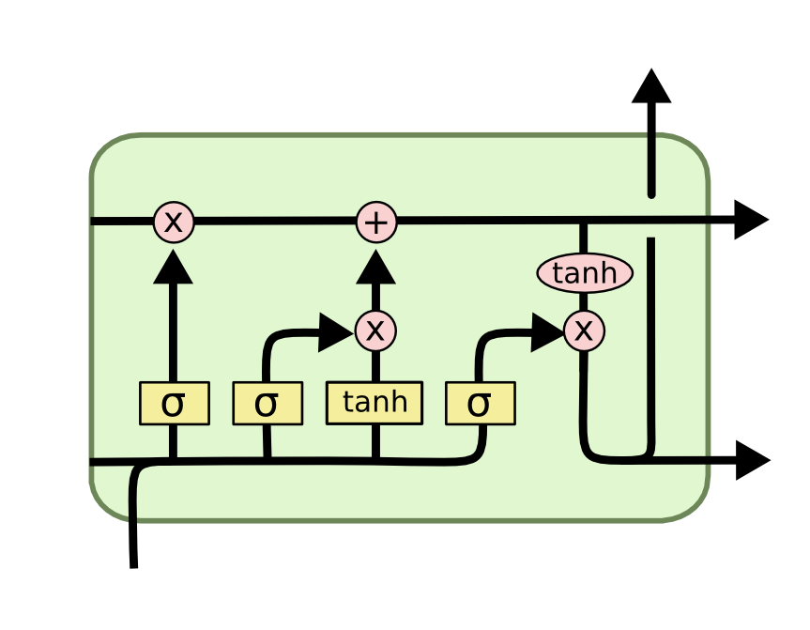
LSTM
Long-Short-Term-Memory
It is a special type of RNN which is capable of remembering something by forgetting something though the distance between the main point and current point is larger
It can remember important things over RNN

Slide 11
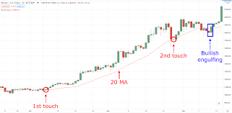
Why 20 days in past ?
In technical analysis, 20 moving avarage is consider to be one of the best tool to analyze stock price
It is consider to be support or resistance to the stock value
It calcuate the avarage for the last 20 trading sessions
Considering 20 moving avarage stratergy, I have choosen days in past for input to LSTM model are 20

Slide 12
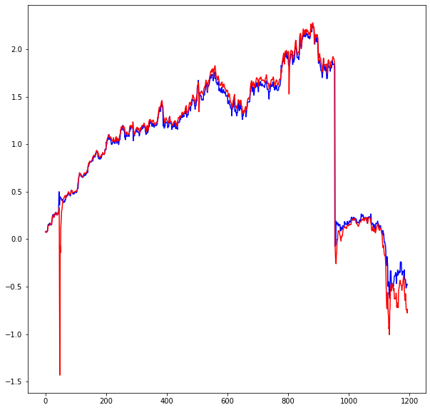
Without Sentiment scores
Predicting next day opening price considering previous 20 days closing price, opening price and volume without considering sentiment scores
RMSE is calculated for tranning data which came out to be
1.251
RMSE is calculated for for testing dats ehich came out to be
1.2882

Slide 13
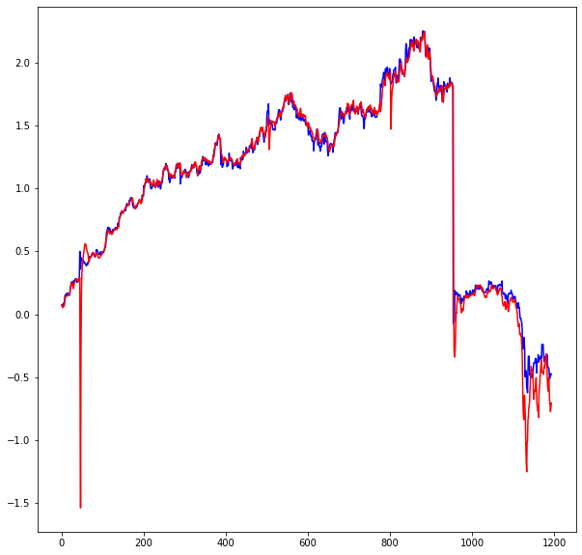
With sentiment scores
This time, Prediction is done using sentiment scorer along with closing price , opening price and volume and tried to figure out where doing sentiment analysis for news really useful or not
So by kipping all the other parameters like no of LSTM, Dense layers, no of epoch, batch size, drop-out exactly similar,
RMSE is calculated for prediction and it came out to be
1.259 which is better than model without sentiments scores

Slide 14
Outcome of project….
RMSE _ACTUAL | RMSE_PRED_WITH-OUT SENTIMENT | RMSE_PRED_WITH SENTIMENT
1.251 | 1.288 | 1.259

Slide 15
Further scope ….
We can deploy model in such a that it can scrap news continuously related to that stock or sector, using pipeline it can generate sentiment score and can provide us next day opening price
It can be converted into an application which can predict price for time interval of next day opening price along with closing price,
price for time interval of 1 minute, 5 minute,10 minute,30 and for
hourly bases aslo using online learning

Slide 16
thank you folks

